Slide 1
Fundamentals of Software Engineering
LECTURE 17: Software Architecture styles

Slide 2
Pipe and Filter Architecture
Pipe and Filter is another architectural pattern, which has independent entities called filters (components) which perform transformations on data and process the input they receive, and pipes, which serve as connectors for the stream of data being transformed, each connected to the next component in the pipeline.

Slide 3
Pipe and Filter Architecture
Many systems are required to transform streams of discrete data items, from input to output. Many types of transformations occur repeatedly in practice, and so it is desirable to create these as independent, reusable parts, Filters.

Slide 4
Description of the Pattern
The pattern of interaction in the pipe-and-filter pattern is characterized by successive transformations of streams of data.
As you can see in the diagram, the data flows in one direction.
It starts at a data source, arrives at a filter’s input port(s) where processing is done at the component, and then, is passed via its output port(s) through a pipe to the next filter, and then eventually ends at the data target.

Slide 5
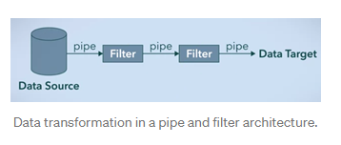
diagram

Slide 6
Description of the Pattern
A single filter can consume data from, or produce data to, one or more ports. They can also run concurrently and are not dependent. The output of one filter is the input of another, hence, the order is very important.
A pipe has a single source for its input and a single target for its output. It preserves the sequence of data items, and it does not alter the data passing through.

Slide 7
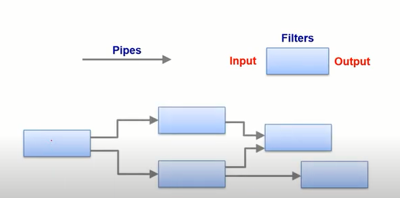
If the dataflow has a single sequence of processes with no alternative or parallel paths, then it is called Batch Sequential

Slide 8
Example
The diagram below shows a simple representation of the pipe and filter architectural style. In this example we demonstrate how a pizza is made using this style. We are using 5 filters, with 3 of them working asynchronously. We implement the first few filters to process the raw ingredients to create the basic elements for the pizza(the vegetables, the sauce, and the pizza base). When all three of these have been completed, we can assemble them. After it has been assembled, we can then add the cheese to the pizza, and bake it, before delivering it to our customer, the sink.

Slide 9
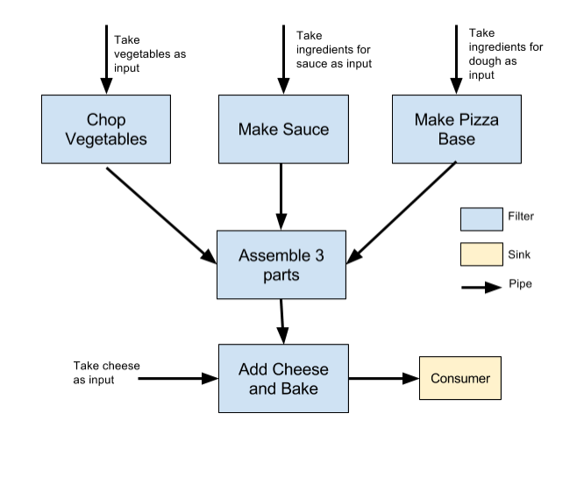

Slide 10
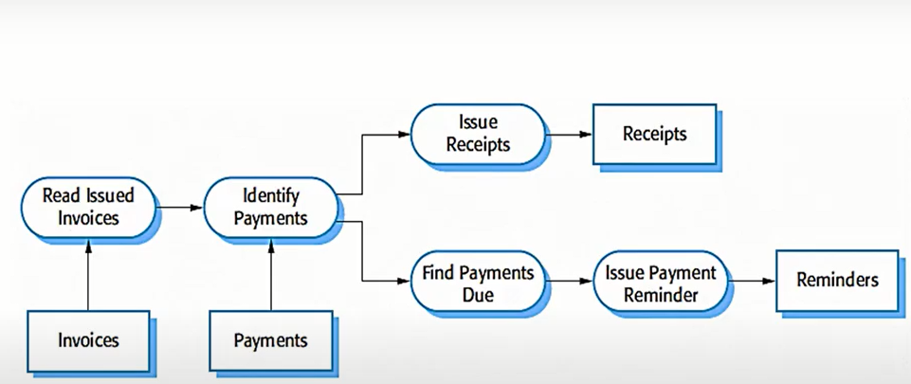

Slide 11
Advantages
Ensures loose and flexible coupling of components, filters.
Loose coupling allows filters to be changed without modifications to other filters.
Conductive to parallel processing.
Filters can be treated as black boxes. Users of the system don’t need to know the logic behind the working of each filter.
Re-usability. Each filter can be called and used over and over again.

Slide 12
drawbacks
Addition of a large number of independent filters may reduce performance due to excessive computational overheads.
Not a good choice for an interactive system.
Pipe-and-fitter systems may not be appropriate for long-running computations.

Slide 13
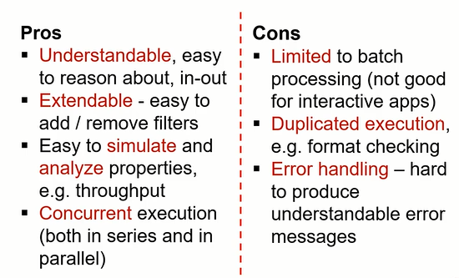

Slide 14
Applications of the Pattern
In software engineering, a pipeline consists of a chain of processing elements (processes, threads, functions, etc.), arranged so that the output of each element is the input of the next.

Slide 15
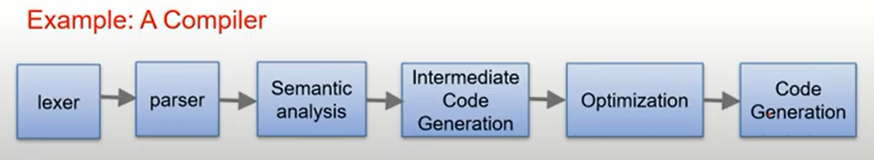
Compilers:
A compiler performs language transformation: Input is in language A and output is in language B. In order to do that the input goes through various stages inside the compiler — these stages form the pipeline. The most commonly used division consists of 3 stages: front-end, middle-end, and back-end.

Slide 16
UNIX Shell:
The Pipeline is one of the defining features of the UNIX shell, and obviously, the same goes for Linux, MacOS, and any other Unix-based or inspired systems.
In a nutshell, it allows you to tie the output of one program to the input of another. The benefit it brings is that you don’t have to save the results of one program before you can start processing it with another. The long-term and even more important benefit is that it encourages programs to be small and simple.

